Slide 1
Objectives
In this session, you will learn to:
  Configure payroll in Tally.ERP 9
  Create payroll masters

Slide 2

Configuring Payroll in Tally.ERP 9
Payroll is a process of maintaining records of the following transactions:
  All employee’s salaries under various pay heads
  All statutory and non-statutory deductions
  Attendance or absence records
  Taxes (if any)
  Pay cheques

Slide 3
Salient Features of Tally.ERP 9’s Payroll
The various key features of the Payroll functionality in Tally.ERP 9:
  It is fully integrated with accounts to give you the benefits of simplified Payroll processing and accounting.
  It has user defined classifications and sub-classifications for comprehensive reporting.
  It provides the facility to create user-defined earnings and deductions Pay Heads.
  It allows flexible and user-definable criteria for simple or complex calculations.
  It allows unlimited grouping of Payroll Masters.

Slide 4
Salient Features of Tally.ERP 9’s Payroll (Contd.)
  It supports the following user-defined production units:
    Attendance
    Production
    Time based remuneration
  It provides a flexible payroll processing period.
  It provides comprehensive Cost Centre as well as
  employee-wise costing reports.
  It ensures an accurate and timely salary processing, employee statutory deductions and employer statutory contributions with the help of predefined processes.
  It provides auto-fill facility to expedite the attendance, payroll and employer contributions processes.
  It facilitates an accurate computation and deduction of ESI, EPF, Professional Tax and Gratuity.

Slide 5
Salient Features of Tally.ERP 9’s Payroll (Contd.)
  It helps in the generation of Statutory Forms and Challans for EPF and ESI, as prescribed.
  It allows drill-down facility to voucher level for any kind of alteration.
  It facilitates computation of arrears pertaining to prior period(s).
  It helps in tracking employee loan details.

Slide 6
Demo: Enabling Payroll in Tally.ERP 9
Problem Statement:
  Let us consider M/s. Indus Solutions Pvt. Ltd., which is engaged in the business of Software services. It is based at Bangalore with the following three major departments:
    Sales
    Administration
    R & D

Slide 7

Demo: Enabling Payroll in Tally.ERP 9 (Contd.)
Let us see how to enable Payroll in Tally.ERP 9.

Slide 8
Creating Payroll Masters
Tally.ERP 9's payroll features:
  Require minimal effort for accurate payroll processing.
  Takes five easy steps to process payroll and generate Payslip in Tally.ERP 9.

Slide 9
Creating Payroll Masters (Contd.)
Payroll involves the calculation of amounts due for an employee on the following basis:
  On hourly wages
  Pay on a fixed basis
  Pay to sales persons on commission
  Reimbursement of expenses
  Pay on number of pieces produced or manufactured or sold

Slide 10
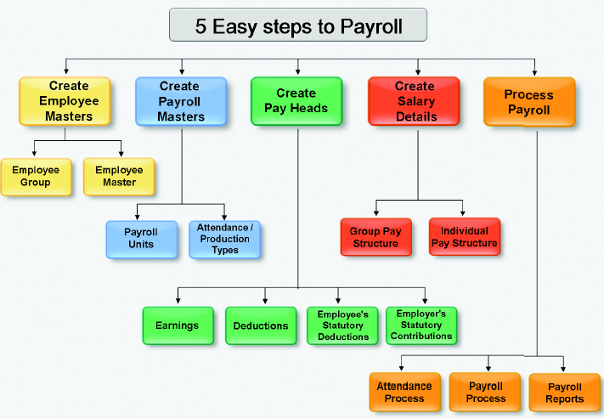
Creating Payroll Masters (Contd.)
The following figure shows the five easy steps to Payroll.

Slide 11
Demo: Creating Employee Group Master
Let us see how to create Sales as an Employee Group in Tally.ERP 9.

Slide 12
Employee Master
In Tally.ERP 9, you can:
  Create individual Employee Masters, with or without grouping them, under the Employee Group Master.
  Record all the necessary information of the employees in the Employee Masters.
  Enter the Statutory, Expat and Contract details of the employees by enabling the following options to Yes:
    Show Statutory Details
    Show Passport & Visa Details
    Show Contact Details

Slide 13
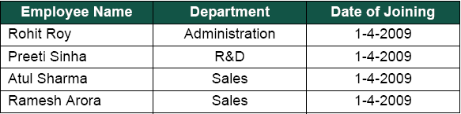
Demo: Creating Employee Masters
Problem Statement:
  Create the following Employee Masters.

Slide 14
Demo: Creating Employee Masters (Contd.)
Let us see how to create Employee Masters in Tally.ERP 9.

Slide 15
Payroll Masters
Payroll Units:
  Refers to a unit of measurement based on which pay heads are calculated.
  Can be classified into the following types:
    Simple Payroll Units
    Compound Payroll Units

Slide 16
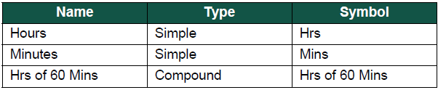
Demo: Creating Payroll Units
Problem Statement:
  Create new Payroll Units based on your business requirements, as shown in the following figure.

Slide 17
Demo: Creating Payroll Units (Contd.)
Let us see how to create Payroll Units inTally.ERP 9.

Slide 18
Attendance/Production Types
Attendance/Production type masters are used to record the nature of attendance or production.
In Tally.ERP 9, you can create Attendance types based on:
  Time
  Work based production units

Slide 19
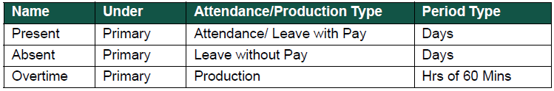
Demo: Creating Attendance Types
Problem Statement:
  Create the Attendance Types for M/s. Indus Solutions Pvt. Ltd., as shown in the following figure.

Slide 20
Demo: Creating Attendance Types (Contd.)
Let us see how to create Attendance Types in Tally.ERP 9.

Slide 21
Summary
In this session, you learned that:
  Payroll is the process of maintaining records of all employees’ salaries.
  The Payroll function in Tally.ERP 9 facilitates accurate and timely employee payments.
  The Attendance/Production Type is used to record attendance and production data.

